Slide 1
TREES
Session 21-22
Course : Z0184-Discrete Mathematics
Effective Period : September 2017

Slide 2
These slides have been adapted from:
Susanna S.Epp. (2010). Discrete Mathematics with Applications.4th edition. Thomson Brooks/Cole. USA. ISBN: 9780534359454
Chapter 11
Acknowledgement

Slide 3
On successful completion of this Course, students will be able to:
Learning Objectives
LO 1: Explain the logic of compound and quantified statements and how do to proof
LO 2: Explain and applying Set Theory, Counting method and Number Theory
LO 3: Explain Function, recursion, fuzzy set, Relations and Graph Theory
LO 4: Explain Trees & Graph theory and its application
LO 5: Explain Automata and graph its application in computer science

Slide 4
Trees
We are not very pleased when we are forced to accept a mathematical truth
by virtue of a complicated chain of formal conclusions and computations, which we
traverse blindly, link by link, feeling our way by touch. We want first an overview of the
aim and of the road; we want to understand the idea of the proof, the deeper context.
— Hermann Weyl, 1885–1955

Slide 5
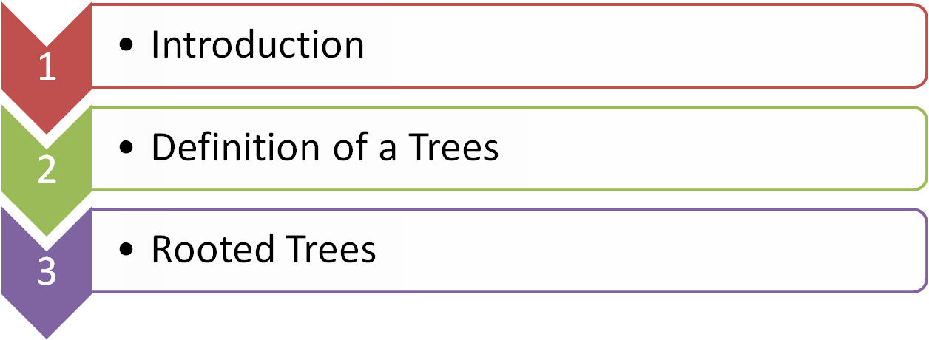


Outline
Spanning Trees and Shortest Paths
Minimum Spanning Trees

Slide 6
INTRODUCTION

Slide 7
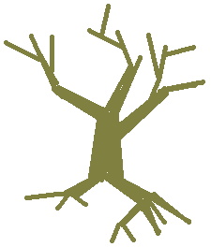
Trees
transformation

Slide 8
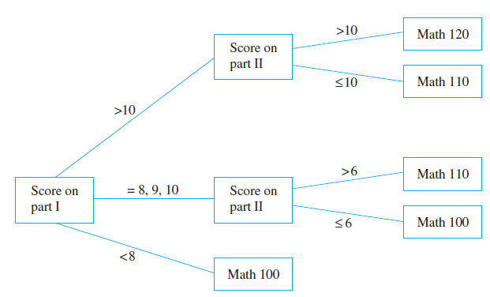
Example of Trees
A Decision Tree
During orientation week, a college administers an exam to all entering students to determine placement in the mathematics curriculum.

Slide 9
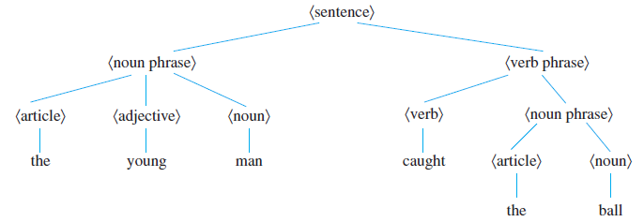
Example of Trees
A Parse Tree
In the study of grammars, trees are often used to show the
derivation of grammatically correct sentences from certain basic rules. Such trees are called syntactic derivation trees or parse trees.

Slide 10
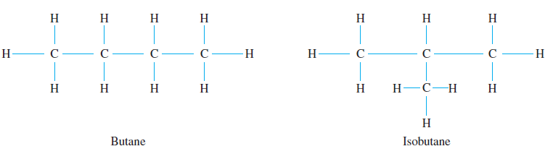
Example of Trees
Structure of Hydrocarbon Molecules

Slide 11
DEFINITION OF TREE

Slide 12
Definition
A graph is said to be circuit-free if, and only if, it has no circuits.
A graph is called a tree if, and only if, it is circuit-free and connected.
A trivial tree is a graph that consists of a single vertex.
A graph is called a forest if, and only if, it is circuit-free and not connected.

Slide 13
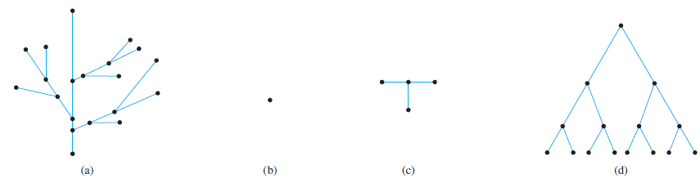
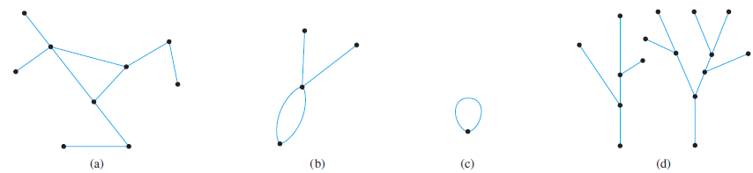
Trees and Non-Trees
All the graph shown below are trees.
All the graph shown below are not trees.

Slide 14
ROOTED TREES

Slide 15
Definition
A rooted tree is a tree in which there is one vertex that is distinguished from the others and is called the root. The level of a vertex is the number of edges along the unique path between it and the root. The height of a rooted tree is the maximum level of any vertex of the tree.

Slide 16
Definition
Given the root or any internal vertex v of a rooted tree, the children of v are all those vertices that are adjacent to v and are one level farther away from the root than v. If w is a child of v, then v is called the parent of w, and two distinct vertices that are both children of the same parent are called siblings. Given two distinct vertices v and w, if v lies on the unique path between w and the root, then v is an ancestor of w and w is a descendant of v.

Slide 17
Component of Tree
node
1
root
node
2
3
4
5
6
7
leaf
node
leaf
8
9
10
leaf
leaf
leaf

Slide 18
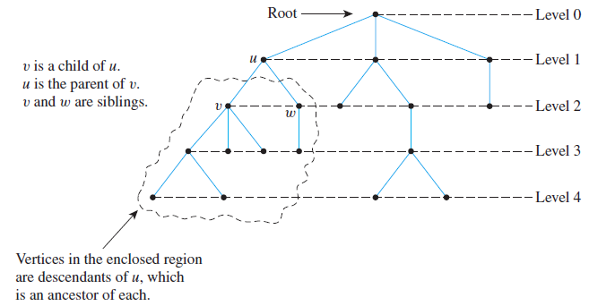
A Rooted Tree

Slide 19
Binary Trees
Definition :
A binary tree is a rooted tree in which every parent has at most two children. Each child in a binary tree is designated either a left child or a right child (but not both), and every parent has at most one left child and one right child.

Slide 20
Binary Trees (Cont’d)
Definition :
A full binary tree is a binary tree in which each parent has exactly two children. Given any parent v in a binary tree T , if v has a left child, then the left subtree of v is the binary tree whose root is the left child of v, whose vertices consist of the left child of v and all its descendants, and whose edges consist of all those edges of T that connect the vertices of the left subtree. The right subtree of v is defined analogously.

Slide 21
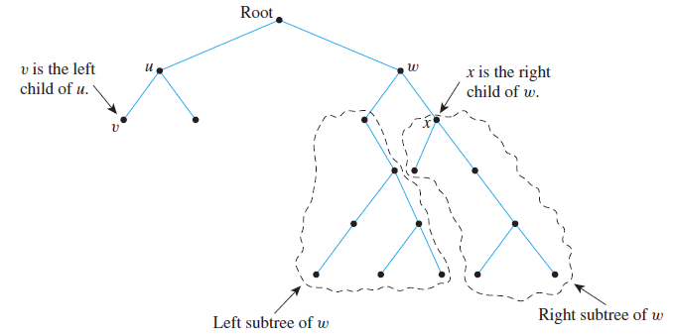
A Binary Tree

Slide 22
SPANNING TREES AND SHORTEST PATHS

Slide 23
Definition
A spanning tree for a graph G is a subgraph of G that contains every vertex of G and is a tree.
Proposition :
1. Every connected graph has a spanning tree.
2. Any two spanning trees for a graph have the same number of edges.

Slide 24
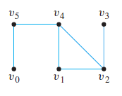
Spanning Trees
Example :
Find all spanning trees for the graph G pictured below.

Slide 25
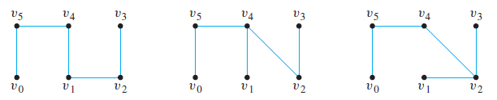
Spanning Trees
Solution:
The graph G has one circuit v2v1v4v2, and removal of any edge of the circuit gives a tree. Thus, as shown below, there are three spanning trees for G.

Slide 26
Problem: Laying Telephone Wire
Central office

Slide 27
Wiring: Naïve Approach
Central office
Expensive!

Slide 28
Wiring: Better Approach
Central office
Minimize the total length of wire connecting the customers

Slide 29
MINIMUM SPANNING TREES

Slide 30
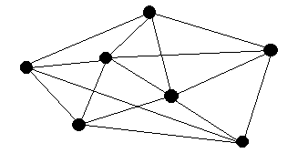
Minimum Spanning Trees
Definition
In a weighted graph , a minimum spanning tree is a spanning tree whose sum of edge weights is as small as possible. It is the most economical tree of a graph with weighted edges.
3
3
3
1
2
3
2
1
4
1
4
1
1
2
1
2
1
5
2
1
5
2
1
1
2
2
4
4

Slide 31
Kruskal's Algorithm
Input: G [a weighed graph with n vertices]
Algorithm Body:
[Build a subgraph Tof G to consist of all the vertices of G with edges added in order of increasing weight. At each stage, let m be the number of edges of T.]
Initialize T to have all the vertices of G and no edges.
Let E be the set of all edges of G, and let m := 0.
While (m < n — 1)
3a. Find an edge e in E of least weight.
3b. Delete e from E.
3c. if addition of e to the edge set of T does not produce a circuit then add e to the edge set of T and set m := m + 1
end while
Output: T

Slide 32
Example: Kruskal’s Algorithm
V₂
3
V₃
V₂
V₂
1
1
V₃
2
After the 1st
iteration
1
3
V₁
1
V₆
V₁
V₁
1
4
1
4
V₂
V₃
V₄
V₄
V₅
1
1
After the 2nd
iteration
1
V₅
V₁
V₅
After the 3rd iteration
V₃
V₂
3
V₃
V₂
1
2
V₁
1
2
1
1
1
V₁
1
V₄
V₅
V₆
V₄
V₅
V₆
After the 4th iteration
After the 5th iteration

Slide 33
Prim's Algorithm
Input: G [a weighted graph with n vertices]
Algorithm Body:
[Build a subgraph T of G by starting with any vertex v of G and attaching edges (with their endpoints) one by one to an as-yet-unconnected vertex of T, each time choosing an adjacent edge of least weight.]
Pick a vertex v of G and let T be the graph with one vertex, v, and no edges.
Let V be the set of all vertices of G except v.
For i := 1 to n — 1
3a. Find an edge e of G such that (1) e connects T to one of the vertices in V, and (2) e has the least weight of all edges connecting T to a vertex in V. Let w be the endpoint of e that is in V.
3b. Add e and w to the edge and vertex sets of T, and delete w from V. next i
Output: T

Slide 34
Example: Prim’s Algorithm
V₁
Algorithm starts
V₂
3
V₃
1
V₂
V₂
V₃
2
V₆
3
V₁
3
1
1
4
V₁
1
1
4
V₁
V₄
V₅
After the 1st iteration
After the 2nd iteration
V₂
V₃
V₃
3
V₂
3
V₂
3
V₃
1
1
1
2
3
1
1
1
V₁
V₁
V₁
1
1
V₆
V₅
V₄
V₅
V₄
V₅
After the 3rd iteration
After the 4thiteration
After the 5th iteration

Slide 35
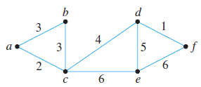
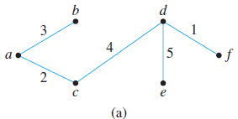
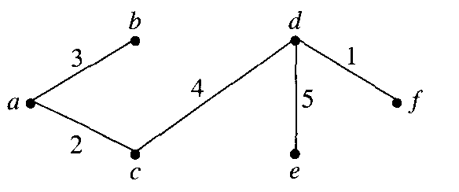
Finding Minimum
Spanning Trees
Find all minimum spanning trees for the following graph.
When Kruskal's algorithm is applied, edges are added in one of the following two orders:
[d, f},[a,c),[a,b},[c,d},{d, e]
[d, f], [a,c], [b, c), [c, d], [d,e]
When Prim's algorithm is applied
starting at a, edges are added in one
of the following two orders:
{a,c],{a,b},[c,d},{d, f},{d, e]
{a,c},{b,c},{c,d},{d,f},{d,e}

Slide 36
Reference
Susanna S.Epp. (2015). Discrete Mathematics with Applications.5th edition. Thomson Brooks/Cole. USA. ISBN: 9780534359454

